Slide 1
Lecture 21
Pattern Recognition with Matlab
Yaohang Li
Department of Computer Science
ODU
Reading for This Class:
Chapter 18.7

Slide 2
Review
Last Class
Learning agents
Performance elements
Learning elements
Learning
Supervised Learning
Reinforced Learning
Unsupervised Learning
Inductive Learning
Ockham’s razor
Learning Algorithms
Learning Decision Tree
Performance Measure
This Class
Pattern Recognition with Matlab
Next Class
Learning using Neural Network

Slide 3
Neural Network Training Example
Breast Cancer Diagnose
https://archive.ics.uci.edu/ml/datasets/Breast+Cancer+Wisconsin+%28Original%29
Diagnosis applied to breast cytology

Slide 4
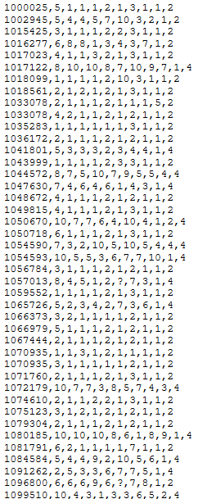
Original Data
1. Sample code number: id number 2. Clump Thickness: 1 - 10 3. Uniformity of Cell Size: 1 - 10 4. Uniformity of Cell Shape: 1 - 10 5. Marginal Adhesion: 1 - 10 6. Single Epithelial Cell Size: 1 - 10 7. Bare Nuclei: 1 - 10 8. Bland Chromatin: 1 - 10 9. Normal Nucleoli: 1 - 10 10. Mitoses: 1 - 10 11. Class: (2 for benign, 4 for malignant)

Slide 5
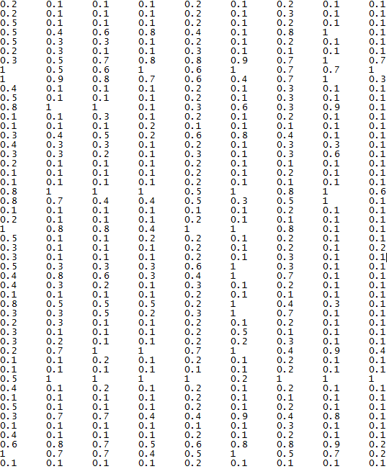

Encoding
Input
Target

Slide 6
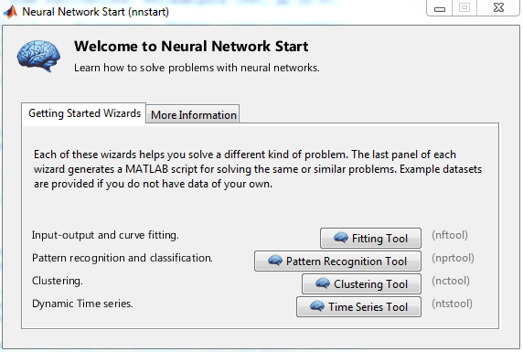
Matlab Neural Network Toolkit
Start Matlab Neural Network Toolkit
nnstart

Slide 7
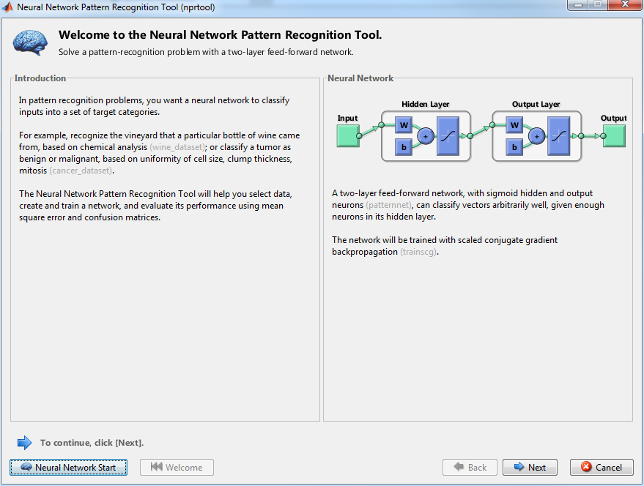
Pattern Recognition Tool

Slide 8
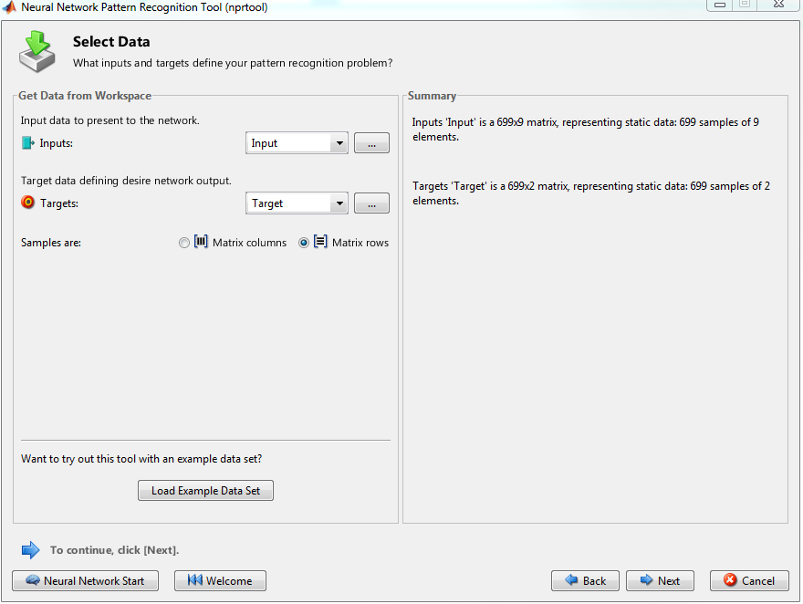
Select Data

Slide 9
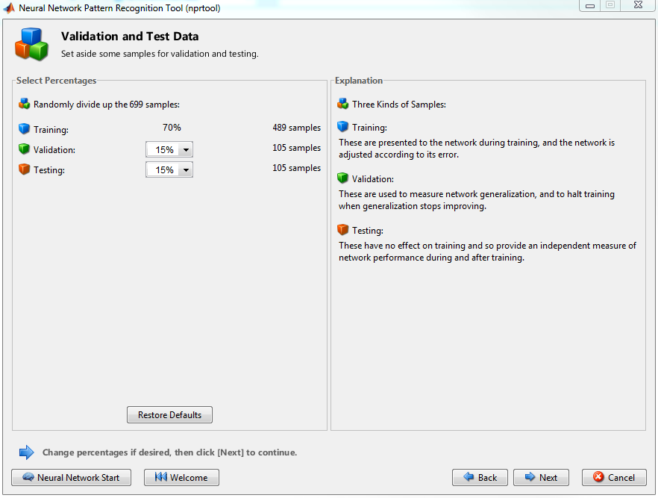
Validation and Test Data

Slide 10
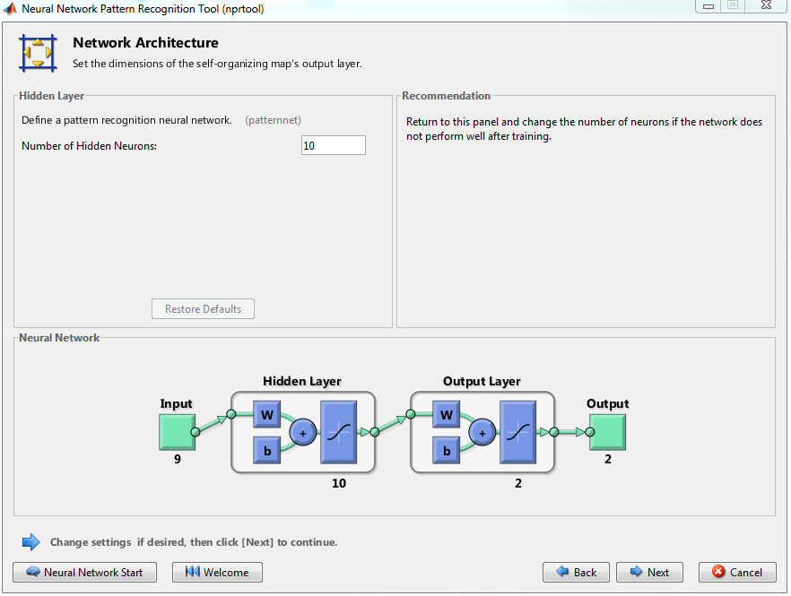
Setup Neural Network

Slide 11
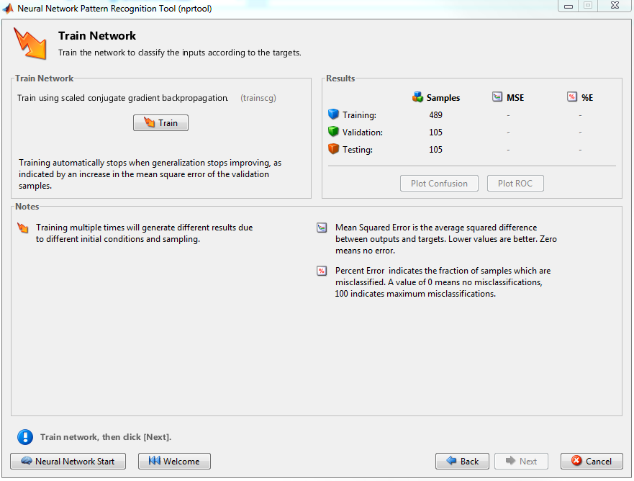
Train Network

Slide 12
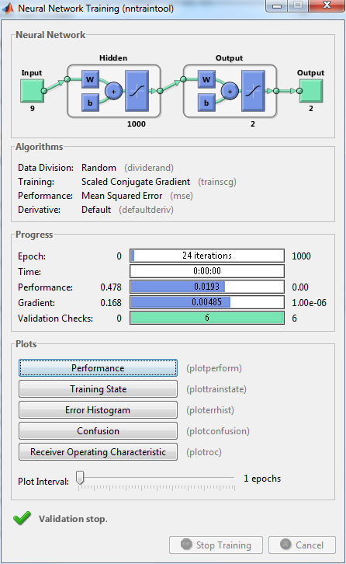
Training

Slide 13
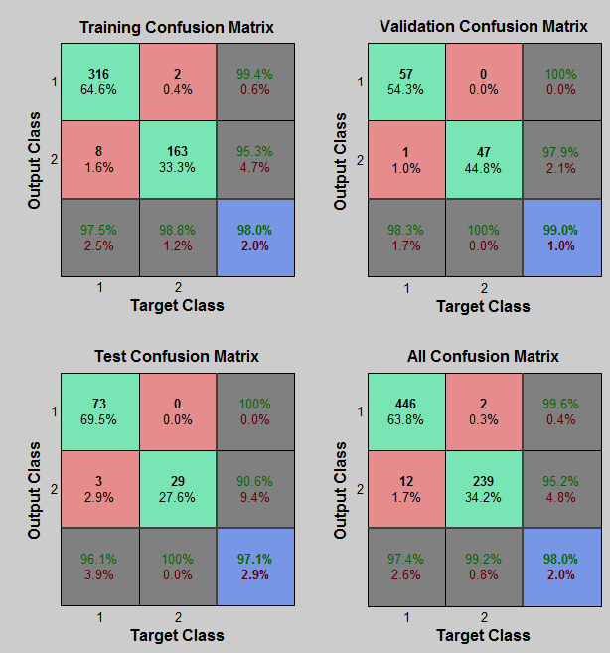
Confusion Matrix
True Positives
With hit
True Negatives
With correct rejection
False Positives
With false alarm
False Negatives
With miss

Slide 14
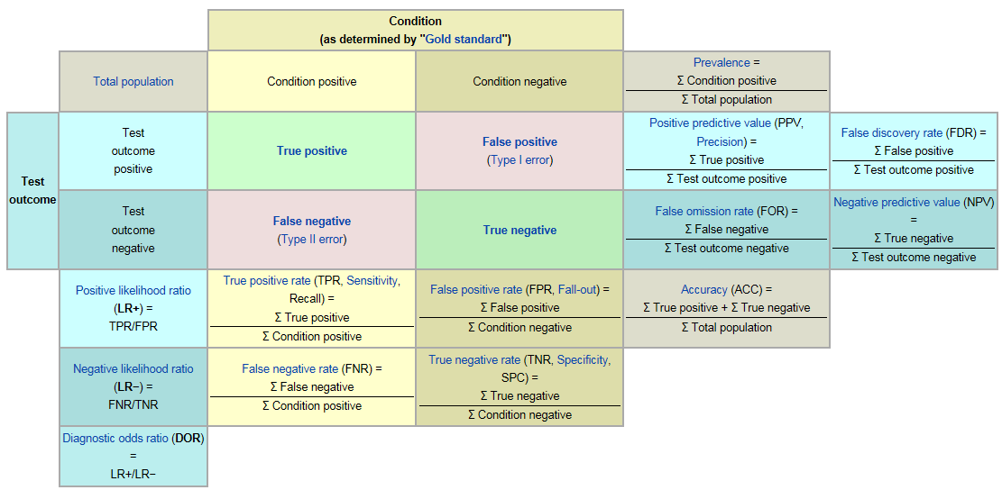
Understanding Confusion Matrix
From Wiki

Slide 15
Summary
Pattern Recognition
Matlab Neural Network Toolbox
Confusion Matrix

Slide 16
What I want you to do
Work on your assignment
Work on your term project

